Slide 1
2021 Annual Meeting

Slide 2
Agenda
Call to Order
Proof of Notice \ Establish Quorum (50% plus one)
Welcome and Introduction of the Board Michael Magnia - President
Approval of 2019 Annual Meeting Minutes Katia Gomez - Secretary
Board Elections (Ballot hand-outs)
Nominations from the Floor
Introduction of Candidates
Election of Directors
2020 Financial Review & Expense as % of Total - Michael Magnia
HOA Updates
Lawsuits
Financial State
Roof Replacements
Foundations
Other Maintenance
Open Forum / General Discussion / Q&A
Election Results – contingent on meeting quorum
Adjournment

Slide 3
2020 Annual meeting minutes
Lifescape Villas on Dublin Annual HOA Meeting
Date | Meeting Start Time |  | Meeting End Time | Location
6.16.2020 | 7:06 PM |  | 8:10 PM | Pool Area
Meeting called by |  | Michael Magnia
Type of meeting |  | Annual HOA Meeting
Facilitator |  | Michael Magnia
Notetaker |  | Katia Gomez
BoardMemebers |  | Michael Magnia(237); Katia Gomez(117) Jerry Palacioz(251); Andrea Jansen(177)
Attendees |  | Guests: Zach Bailey (Associa); Vicki Moore (Associa); Homeowners: 14 Homeowners
Topic
Quorum
Meeting Minutes (Prior Meeting)
Notes
Requirement: 50% plus one Board members quorum met for the meeting. Homeowner quorum not met for the meeting.
Meeting Minutes Approved
Motion | Andrea Jansen
Second | Jerry Palacioz
Reports | Presented by | Notes
Financial | Michael Magnia | Presented 2019 EOY balances Vs current 2020 account balance Presented Budget by Expense Group Discussed proposed loan in process High Delinquency on special assessments dues
Property Updates | Michael Magnia | Roofs Update We are currently in phase 2 or 3 of Roof Assessment 2019: had A LOT of leaks. most have been resolved 11/24 roofs have been replaced since 2018 Plan to replace 3 roofs in 2020 Skylight replacements as part of roof replacement scope
 | Michael Magnia | Foundations Completed foundation work on F,L & T Building D Does nto require foundation work Next buildings: U,V, & S. Has been going slow due to COVID
 | Michael Magnia | Carport Seeking bids. Pending loan/funds
 | Michael Magnia | Interior Repairs Next major item to hit budget Due to leaks and foundation work

Slide 4
2020 Financial review
 | Net Income / (Loss) |  | ($124,675.90) |  | ($241.34)
 | Total Liabilities and Equity |  | $420,275.68 |  | $44,172.25
Income Statement
 |  |  | 2020 | 2020 | 2021 | 2021
 |  |  | Year End | Budgeted | Year to Date | Budget
Operating Funds
 | Income
 | Total Assessment Income |  | $ 303,816.12 | $ 303,815.64 | $ 50,636.02 | $ 56,705.00
 | Total Collections Income |  | $ 1,921.59 | $ - | $ 641.74 | $ -
 | Total Other Income |  | $ 11.67 | $ - | $ 15.00 | $ -
 | Total Investment Income |  | $ - | $ - | $ - | $ -
 | Total Income |  | $ 305,749.38 | $ 303,815.64 | $ 51,292.76 | $ 56,705.00
 | Expenses
 | Total Administrative Expenses |  | $ 9,295.88 | $ 2,547.00 | $ 2,785.11 | $ 1,188.00
 | Total Communication Expenses |  | $ 1,565.09 | $ 2,000.00 | $ 1,266.74 | $ 270.00
 | Total Insurance Expenses |  | $ 53,887.78 | $ 52,865.00 | $ 7,525.50 | $ 9,569.00
 | Total Utilities |  | $ 86,286.50 | $ 71,399.46 | $ 6,759.70 | $ 15,630.00
 | Total Landscaping |  | $ 14,279.45 | $ 38,000.00 | $ 2,100.00 | $ 2,700.00
 | Total Irrigation |  | $ 5,757.00 | $ 3,000.00 | $ - | $ 800.00
 | Total Operations - Permits |  | $ 400.00 | $ 200.00 | $ - | $ -
 | Total Contracted Services |  | $ 5,570.11 | $ 8,100.00 | $ 998.88 | $ 1,080.00
 | Total Repairs & Maintenance |  | $ 35,549.85 | $ 51,434.85 | $ 20,817.57 | $ 10,897.00
 | Total Professional Services |  | $ 83,761.45 | $ 23,602.00 | $ 4,216.60 | $ 4,351.00
 | Total Other Expenses |  | $ 30,382.00 | $ 30,381.56 | $ 5,064.00 | $ 5,064.00
 | Total Reserve Contributions |  |  | $ - | $ - | $ -
 | Total Expense |  | $ 326,735.11 | $ 283,529.87 | $ 51,534.10 | $ 51,549.00
 | Net Income/(Loss) |  | $ (20,985.73) | $ 20,285.77 | $ (241.34) | $ 5,156.00
 |  |  | 2019 | 2019 | 2020 | 2020
 |  |  | Year End | Budgeted | Year to Date | Budget
Reserve Funds
 | Income
 | Total Investment Income |  | $ 313,430.75 | $ 30,381.56 | $ 5,105.54 | $ 5,064.00
 | Total Income |  | $ 313,430.75 | $ 30,381.56 | $ 5,105.54 | $ 5,064.00
 | Expenses
 | Admin |  | $ 5,000.00 | $ - | $ - | $ -
 | General Expenses |  | $ 60,635.83 | $ - | $ - | $ -
 | Total Expense |  | $ 65,635.83 | $ - | $ - | $ -
 | Net Income/(Loss) |  | $ 247,794.92 | $ 30,381.56 | $ 5,105.54 | $ 5,064.00
Roof Reserve Funds
 | Income
 | Total Assessment Income |  | $ 149,601.05 | $ 125,000.00 | $ 18,862.47 | $ 20,833.00
 | Total Collections Income |  | $ 1,642.92 | $ - | $ 340.00 | $ -
 | Total Investment Income |  | $ 45.42 | $ - | $ 4.61 | $ -
 | Total Income |  | $ 151,289.39 | $ 125,000.00 | $ 19,207.08 | $ 20,833.00
 | Expenses
 | Roof Expenses |  | $ 183,425.72 | $ 125,000.00 | $ 1,600.00 | $ 20,833.00
 | Total Expense |  | $ 183,425.72 | $ 125,000.00 | $ 1,600.00 | $ 20,833.00
 | Net Income/(Loss) |  | $ (32,136.33) | $ - | $ 17,607.08 | $ -
Foundation Reserve Funds
 | Income
 | Total Assessment Income |  | $ (335.46) | $ - | $ (70.00) | $ -
 | Total Collections Income |  | $ 508.56 | $ - | $ - | $ -
 | Total Investment Income |  | $ 183.30 | $ - | $ 18.84 | $ -
 | Total Income |  | $ 356.40 | $ - | $ (51.16) | $ -
 | Expenses
 | Total Administrative Expenses |  | $ 50.00 | $ - | $ 60.00 | $ -
 | Repair & Maintenance |  | $ 991.24 | $ - | $ 15,946.02 | $ -
 | Total Professional Services |  | $ 7,475.00 | $ - | $ - | $ -
 | Total Reserve Expense |  | $ 28,294.65 | $ 125,000.00
 | Total Expense |  | $ 36,810.89 | $ 125,000.00 | $ 16,006.02 | $ -
 | Net Income/(Loss) |  | $ (36,454.49) | $ (125,000.00) | $ (16,057.18) | $ -

Slide 5
2020 expense as % of Total

Slide 6
Hoa updates
New Property Manager
Anthony Lopez, Community Manager - anthony.lopez@principal-mgmt.com
Customer Care – ntxcustomercare@associa.us
Lawsuits
Lifescape v Peleus – designation dates set 04/19 and 05/17
Lifescape VIllas on Dublin v. Western World Ins. Co. - settlement negotiations underway
Financial State
Obtained $300,00 loan to resolve invoice backlog, replace carport, and work through reserve study recommendations
Roof Replacements
We are on phase 2 of 3 of Roof Special Assessment
Eleven roofs have been replaced since 2018
Roofs replaced in 2020: T, Z, W, X, and Y
Pending Update of skylights on Bldgs. W and Y
Roof Replacement Candidates for 2021 – Bldgs. N, G, and H
Material and labor increases observed in 2021
Phase 3 projected to start in 2023

Slide 7
Hoa updates
Foundations
Completed foundation work on buildings L and S
Bldg. U foundation work delayed while Board evaluates different repair plans
Based on feedback from the engineer, foundation work on Bldg. V can be forgone to invest in drainage solutions
Drainage solutions for Bldgs. D, M, and Mud-alley being bid by Diffee Landscaping
Material and labor increases observed in 2021
Other Maintenance
Interior Repairs Related to Roof Leaks & Foundation Repairs – homeowners are encouraged to request their own bids for repair, submitting to the Board for consideration
Exterior trim, fascia repairs bidding in process
Select architectural element removal being bid as part of lowering future damage
Masonry repairs for cracked brick and unsatisfactory repairs being evaluated
Fences replaced in 2020 and 2021 Bldg A, R205, Bldg V223 & 233 – Bldg Y253 & 251
Additional fences to be repaired on a quarterly basis and based on available funds
Bldgs. F, G, and H sewer line repairs – underway
Driveway concrete repair and striping

Slide 8
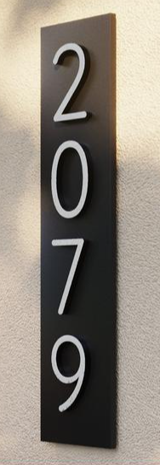
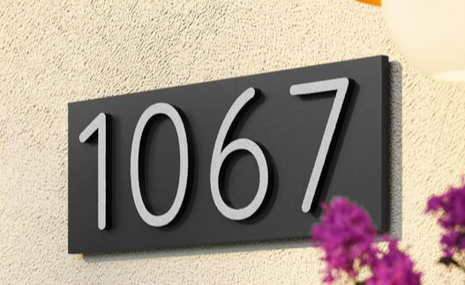
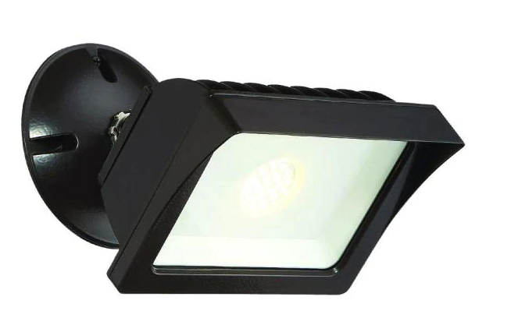
What’s next
Pool Gate Locks – estimated cost $565
Address Plaques – estimated cost $2960
Carport Lights – estimated cost $1783

